Slide 1
In a web browser (Google Chrome, Microsoft Edge, etc.) navigate to www.orionassoc.net.

Slide 2
Click on "Training" at the top of the page.

Slide 3
From this page, click "My Learning Page"

Slide 4
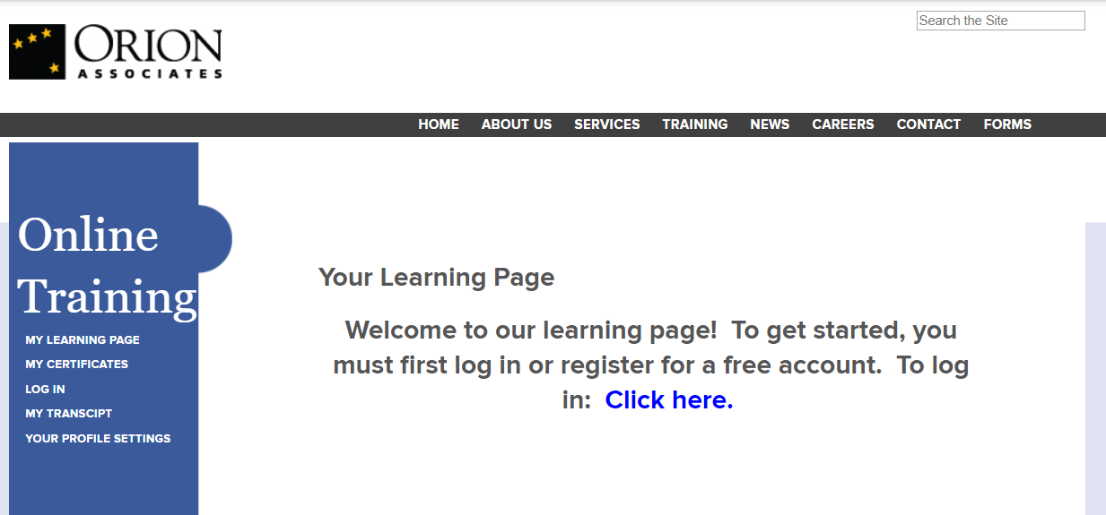
If not previously logged in, you will see this page. Click, "Click here".

Slide 5
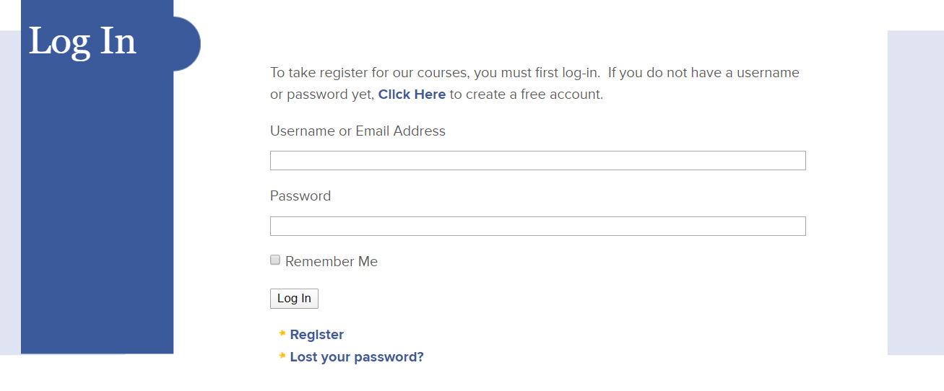
Use this page to login using the learndash login information that was provided to you.

Slide 6
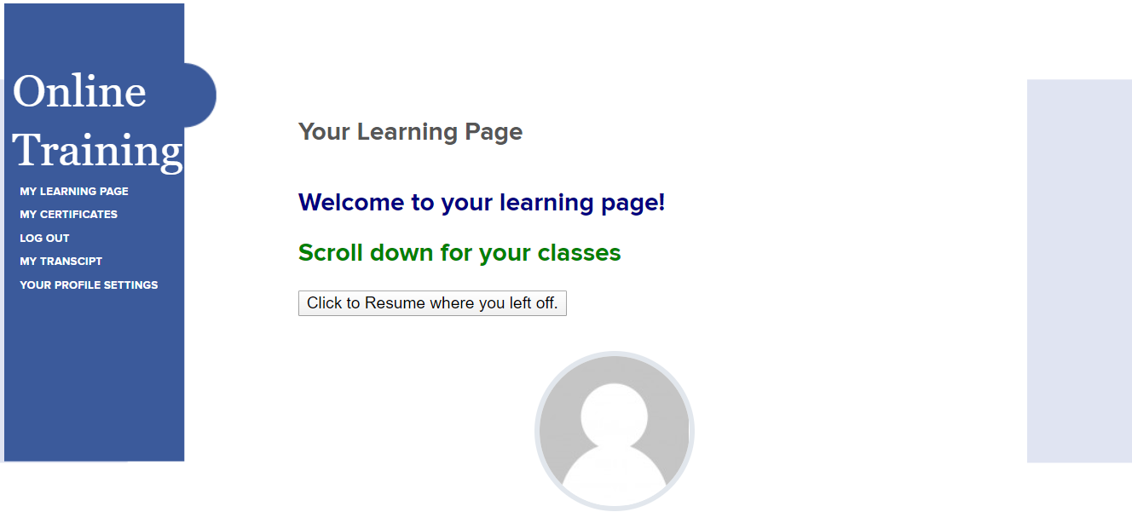
A page that looks like this will appear. From here, scroll down to select courses.

Slide 7
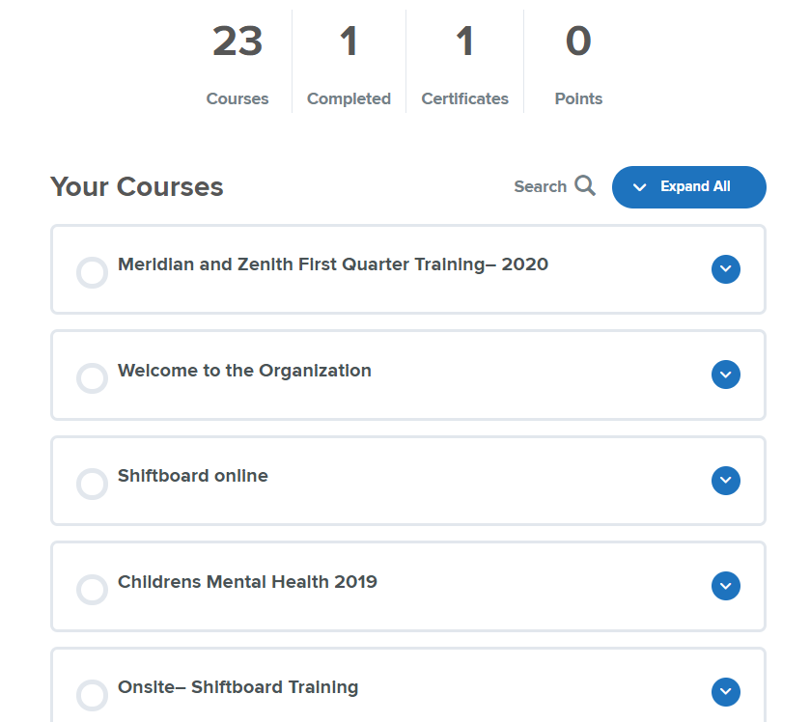
Click on the name of the course you would like to complete.
Note: New employees do not need to complete the "Meridian and Zenith First Quarter Training – 2020". At this time, new employees may also disregard any training beginning with the word "onsite" or "Protected".

Slide 8
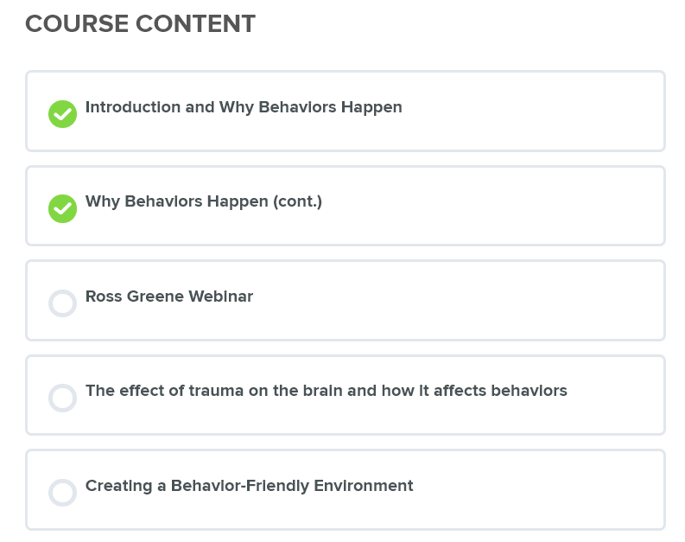
Several of the courses have many lessons. There are also quizzes to complete with the courses and lessons. Complete each of the lessons and quizzes to complete the course. Once a lesson or course is completed, a checkmark will appear next to it.
Note: Please watch videos contained in these pages without clicking on the video to watch in youtube. If the video is watched in youtube, even if completed, it will not be credited as complete.

